Slide 1
Unit-3

Slide 2
Java 8 Features
Functional Interfaces
Lambda Expression
Method References
Stream API
Default Methods
Static Method
Base64 Encode and Decode
Etc.

Slide 3
Advantages of Java8 new features
Developers may now take use of new functional programming techniques introduced in Java 8 to create code that is both shorter and more expressive.
Lambda expressions, functional interfaces, the Stream API, the Reference to Methods, and the Optional class are all examples of such features.

Slide 5
Lambda Expression
The Lambda expression is used to provide the implementation of a functional interface.
It helps to iterate, filter and extract data from collection.
In case of lambda expression, we don't need to define the method again for providing the implementation.
It saves a lot of code i.e. less coding.

Slide 6
Java Lambda Expression Syntax
(argument-list) -> {body}
Java lambda expression is consisted of three components:
1) Argument-list: It can be empty or non-empty as well.
2) Arrow-token: It is used to link arguments-list and body of expression.
3) Body: It contains expressions and statements for lambda expression.

Slide 7
Types of Lambda Expression
A body with single expression
A body that consists of block of code
No parameter Syntax:
( ) -> {
//Body of no parameter lambda
}
One Parameter Syntax
(p1) -> {
//Body of single parameter lambda
}
Two Parameter Syntax
(p1,p2) -> {
//Body of multiple parameter lambda
}

Slide 8
What is Functional Interface in Java?
An Interface that contains exactly one abstract method is known as functional interface.
It can have any number of default and static methods but can contain only one abstract method.
It is known as Single Abstract Method Interfaces(SAM).
It helps in functional programming task.
Interface with an annotation called @FunctionalInterface.
We can invoke Lambda expression by using functional interface.
Runnable, ActionListener, Consumer<T>, and Comparable<T> are some examples of functional interfaces.

Slide 9
Example of Lambda Expression with one parameter
@functional interface
interface NumericTest{
boolean test(int n);
}
public class LambdaDemo1 {
public static void main(String args[]) {
NumericTest isEven= (n) -> (n%2)==0;
if(isEven.test(10)) System.out.println("10 is even");
if(!isEven.test(9)) System.out.println("9 is not even");
}
}

Slide 10
How to define Functional Interface?
No need to use the abstract keyword, by default, method defined inside the interface is abstract only.
@FunctionalInterface
interface Sample{
void display(String msg);
}
public class FInterfaceDemo implements Sample {
public void display(String msg){
System.out.println(msg);
}
public static void main(String[] args) {
FInterfaceDemo f = new FInterfaceDemo();
f.display("functional interface demo");
} }

Slide 11
Advantage of Annotation (@)
It restrict the interface to be a functional interface.
e.g. if one person has defined one abstract method and is using Lambda expression and another person added one more abstract method in the same functional interface, then all lambda expressions will have errors.

Slide 12
Default Methods
Before Java 8, interfaces could have only abstract methods.
The implementation of these methods has to be provided in a separate class.
So, if a new method is to be added in an interface, then its implementation code has to be provided in class implementing the same interface.
To overcome this issue, Java 8 has introduced the concept of default methods which allow the interfaces to have methods with implementation without affecting the classes that implement the interface.
Default methods are also known as defender methods or virtual extension methods.

Slide 13
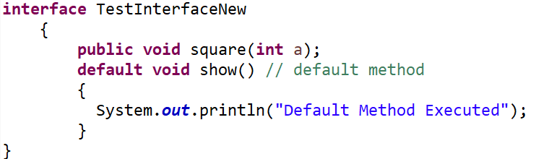
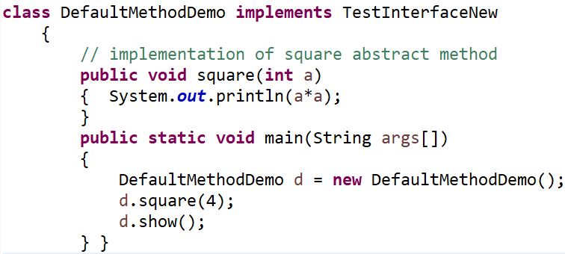
Default Methods: Example Java program

Slide 14
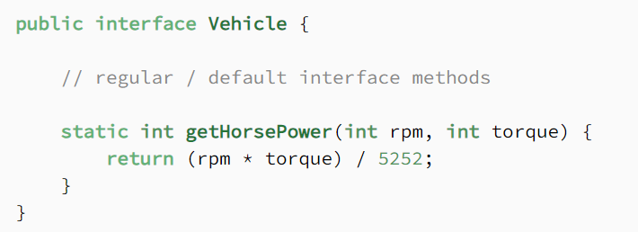
Static Method in Interface
Java 8 also allows us to define and implement static methods in interfaces.
Since static methods don’t belong to a particular object, they’re not part of the API of the classes implementing the interface
they have to be called by using the interface name preceding method name.

Slide 15
Java Predefined-Functional Interfaces
Java provides predefined functional interfaces to deal with functional programming by using lambda and method references.
Interface | Description
BiConsumer<T,U> | It represents an operation that accepts two input arguments and returns no result.
Consumer<T> | It represents an operation that accepts a single argument and returns no result.
Function<T,R> | It represents a function that accepts one argument and returns a result.
Predicate<T> | It represents a predicate (boolean-valued function) of one argument.
BiFunction<T,U,R> | It represents a function that accepts two arguments and returns a result.
BinaryOperator<T> | It represents an operation upon two operands of the same data type. It returns a result of the same type as the operands.

Slide 16
Method References
Java provides a new feature called method reference in Java 8.
Method reference is used to refer method of functional interface.
It is compact and easy form of lambda expression.
Each time when you are using lambda expression to just referring a method, you can replace your lambda expression with method reference.
Three types are there:-
-Reference to a static method.
-Reference to an instance method.
-Reference to a constructor.

Slide 17
Reference to a Static Method
A static method reference refers to a static method in a specific class.
Its syntax is className::staticMethodName
Where classname identifies the class
staticMethodName identifies the method
public class MethodReference2 {
public static void ThreadStatus(){
System.out.println("Thread is running...");
}
public static void main(String[] args) {
Thread t2=new Thread(MethodReference2::ThreadStatus);
t2.start();
}
}

Slide 18
Reference to an instance method
like static methods, you can refer instance methods also
The syntax is---
containingObject::instanceMethodName
public class InstanceMethodReference2 {
public void printnMsg(){
System.out.println("Hello, this is instance method");
}
public static void main(String[] args) {
Thread t2=new Thread(new InstanceMethodReference2()::printnMsg);
t2.start();
}
}

Slide 19
Reference to a constructor
Refer a constructor by using the new keyword.
we are referring constructor with the help of functional interface.
The syntax is ---
interface Messageable{
Message getMessage(String msg);
}
class Message{
Message(String msg){
System.out.print(msg);
}
}
public class ConstructorReference {
public static void main(String[] args) {
Messageable hello = Message::new;
hello.getMessage("Hello");
}
}
ClassName::new

Slide 20
Stream API
Introduced in Java 8, Stream API is used to process collections of objects.
A stream in Java is a sequence of objects that supports various methods which can be pipelined to produce the desired result.
A stream operates on a data source, such as an array or a collection.
A stream, itself, never provides storage for the data.
Uses of Stream API
Stream API is a way to express and process collections of objects.
Enable us to perform operations like filtering, mapping, reducing and sorting.

Slide 21
How to Create Java Stream?
Java Stream Creation is one of the most basic steps before considering the functionalities of the Java Stream. Below is the syntax given on how to declare Java Stream.
Syntax
Stream<T> stream;
Here T is either a class, object, or data type depending upon the declaration.
You can use stream by importing java.util.stream package

Slide 22
Stream API Features
Stream does not store elements.
It simply conveys elements from a source such as a data structure, an array, or an I/O channel, through a pipeline of computational operations.
Streams don’t change the original data structure, they only provide the result as per the pipelined methods.
Each intermediate operation is lazily executed and returns a stream as a result, hence various intermediate operations can be pipelined. Terminal operations mark the end of the stream and return the result.
The elements of a stream are only visited once during the life of a stream. Like an Iterator, a new stream must be generated to revisit the same elements of the source.

Slide 23
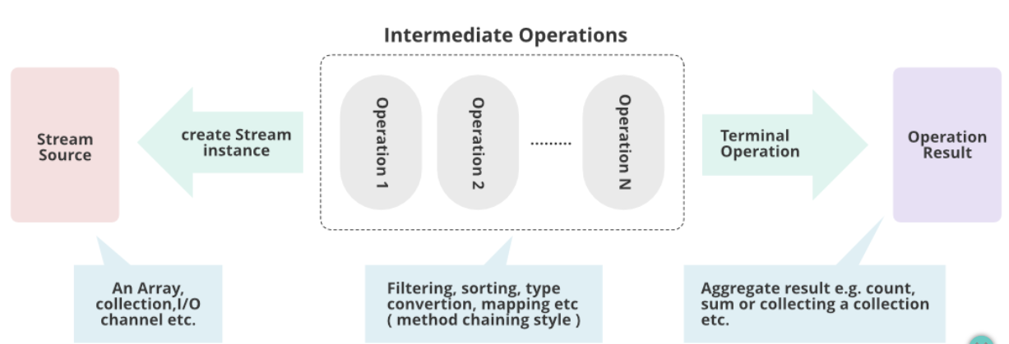
Stream API

Slide 24
Stream Operations
Stream operations are divided into two types:-
Intermediate operations
Terminate operations
Intermediate-
Methods are chained together.
Intermediate operations transform a stream into another stream.
It enables the concept of filtering where one method filters data and passes it to another method after processing.
Terminal- Terminal Operations are the type of Operations that return the result. These Operations are not processed further just return a final result value.

Slide 25
Few Intermediate Operations
Method | Meaning | Syntax
map() | The map method is used to return a stream consisting of the results of applying the given function to the elements of this stream. | List number = Arrays.asList(2,3,4,5); List square = number.stream().map(x->x*x).collect(Collectors.toList());
filter() | The filter method is used to select elements as per the Predicate passed as an argument. | List names = Arrays.asList("Reflection","Collection","Stream"); List result = names.stream().filter(s->s.startsWith("S")).collect(Collectors.toList());
sort() | The sorted method is used to sort the stream. | List names = Arrays.asList("Reflection","Collection","Stream"); List result = names.stream().sorted().collect(Collectors.toList());

Slide 26
Few Terminal Operations
Method | Meaning | Syntax
collect() | The collect method is used to return the result of the intermediate operations performed on the stream. | List number = Arrays.asList(2,3,4,5,3); Set square = number.stream().map(x->x*x).collect(Collectors.toSet());
forEach() | The forEach method is used to iterate through every element of the stream. | List number = Arrays.asList(2,3,4,5); number.stream().map(x->x*x).forEach(y->System.out.println(y));
reduce() | The sorted method is used to sort the streThe reduce method is used to reduce the elements of a stream to a single value. The reduce method takes a BinaryOperator as a parameter. | List number = Arrays.asList(2,3,4,5); int even = number.stream().filter(x->x%2==0).reduce(0,(ans,i)-> ans+i);

Slide 27
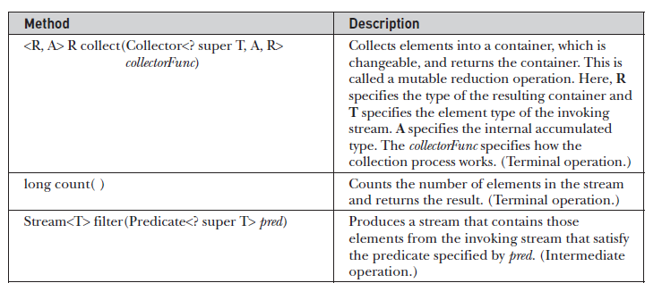
Stream Interface

Slide 28
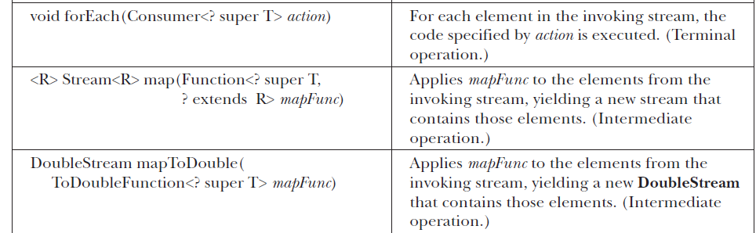
Stream Interface

Slide 29
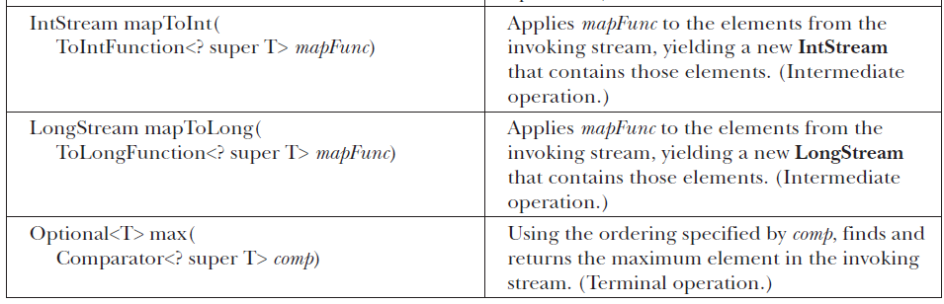
Stream Interface

Slide 30
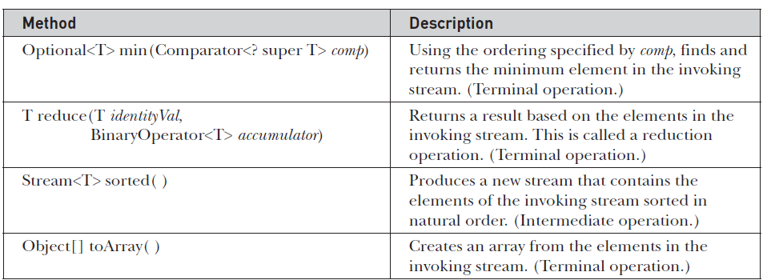
Stream Interface

Slide 31
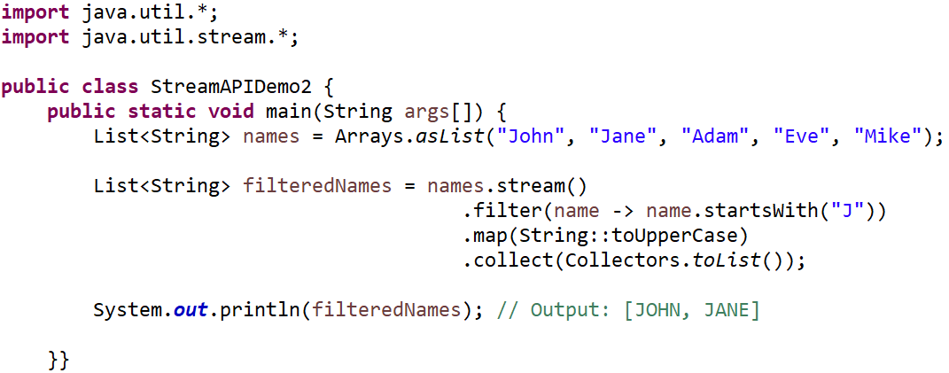
Example Java program to show intermediate operations

Slide 32
Reduction operations
Many times, we need to perform operations where a stream reduces to single resultant value, for example, maximum, minimum, sum, product, etc.
Reducing is the repeated process of combining all elements.
sum(), min(), max(), count() etc. are some examples of reduce operations.

Slide 33
Base64 Encode and Decode
Base 64 is an encoding scheme that converts binary data into text format so that encoded textual data can be easily transported over network un-corrupted and without any data loss.
Java provides a class Base64 to deal with encryption.
We can encrypt and decrypt data by using provided methods.
java.util.Base64 need to be imported in source file to use its methods.
There are 3 types of encoding and decoding capabilities as standard.
-Base or Simple Type
-URL Encoding/Decoding
-MIME Encoding/Decoding (Multipurpose Internet Mail Extensions)

Slide 34
Java 8 Basic Base64
It uses the Base64 alphabet specified by Java in RFC 4648 and RFC 2045 for encoding and decoding operations.
The basic encoder keeps things simple and encodes the input as-is, without any line separation.
The encoder maps the input to a set of characters in the A-Za-z0-9+/ character set.
The decoder rejects data that contains characters outside the base64 alphabet.
encoding String--
Decoding String--

Slide 35
Java 8 Base64 Encoding Without Padding
In Base64 encoding, the length of an output-encoded String must be a multiple of four. If necessary, the encoder adds one or two padding characters (=) at the end of the output as needed in order to meet this requirement.
Upon decoding, the decoder discards these extra padding characters.
we need to skip the padding of the output. For instance, the resulting String will never be decoded back. So, we can simply choose to encode without padding.

Slide 36

Java 8 URL Encoding and decoding
The URL encoding is the same as Basic encoding the only difference is that it encodes or decodes the URL and Filename safe Base64 alphabet and does not add any line separation.

Slide 37
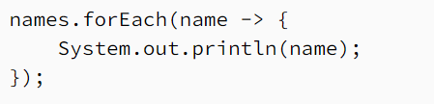
ForEach Method
Java provides a new method forEach() to iterate the elements. It is defined in Iterable and Stream interface. It is a default method defined in the Iterable interface. Collection classes which extends Iterable interface can use forEach loop to iterate elements.
This method takes a single parameter which is a functional interface. So, you can pass lambda expression as an argument.
forEach() Signature in Iterable Interface:
default void forEach(Consumer<super T>action)
Where, Consumer is a functional interface and T is the type of stream elements.

Slide 38
ForEach Method Example
import java.util.Arrays;
import java.util.List;
public class ForEachExample {
public static void main(String[] args) {
List<String> names = Arrays.asList("Alice", "Bob", "Charlie");
// Using forEach with a lambda expression
names.forEach(n -> System.out.println(n));
// Using forEach with a method reference
names.forEach(System.out::println);
}
}

Slide 39
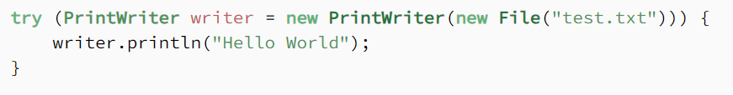
Try-with-resources
The try-with-resources statement is a try statement that declares one or more resources.
The resource is as an object that must be closed after finishing the program. The try-with-resources statement ensures that each resource is closed at the end of the statement execution.
This ensures resources are released, preventing leaks and improving code reliability.
You can pass any object that implements java.lang.AutoCloseable, which includes all objects which implement java.io.Closeable.

Slide 40
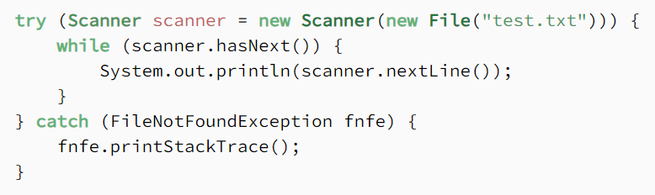
Try-with-resources
Try-with-resources can replace try-catch-finally block.

Slide 41
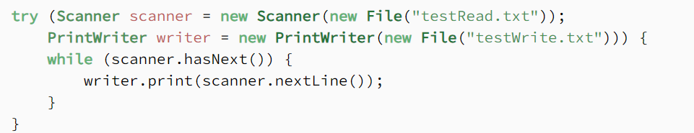
try-with-resources With Multiple Resources
We can declare multiple resources in a try-with-resources block by separating them with a semicolon(;)
e.g:

Slide 42
Type Annotations
After releasing of Java SE 8 , annotations can be applied to any type use.
It means that annotations can be used anywhere you use a type. For example, if you want to avoid NullPointerException in your code, you can declare a string variable like this:
@NonNull String str;
Type annotations were created to support improved analysis of Java programs way of ensuring stronger type checking.
More Examples:
@Open Connection connection , @NonNull List<String> ,
Arrays<@NonNegative Integer> sort

Slide 43
Repeating Annotations
Java allows you to repeating annotations in your source code.
It is helpful when you want to reuse annotation for the same class.
For compatibility reasons, These are stored in a container annotation that is automatically generated by the Java compiler.
In order for the compiler to do this, two declarations are required in your code:
Declare a repeatable annotation type
Declare the containing annotation type

Slide 44
Declare a repeatable annotation type
Declaring of repeatable annotation type must be marked with the @Repeatable meta-annotation.
In the following example, we have defined a custom @Game repeatable annotation type.
@Repeatable(Games.class)
@interfaceGame{
String name();
String day();
}

Slide 45
Declare the containing annotation type
Containing annotation type must have a value element with an array type.
The component type of the array type must be the repeatable annotation type.
Example- declaring Games containing annotation type:
@interfaceGames{
Game[] value();
}

